Slide 1
Single Final State for NFAs

Slide 2
Any NFA can be converted
to an equivalent NFA
with a single final state

Slide 3



Example
NFA
Equivalent NFA

Slide 4
In General
NFA
Equivalent NFA
Single
final state

Slide 5
Extreme Case
NFA without final state
Add a final state
Without transitions

Slide 6
Properties of
Regular Languages

Slide 7




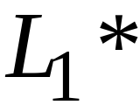
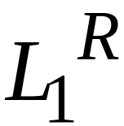


For regular languages and
we will prove that:
Union:
Concatenation:
Are regular
Languages
Star:
Reversal:
Complement:
Intersection:

Slide 8
We say: Regular languages are closed under
Union:
Concatenation:
Star:
Reversal:
Complement:
Intersection:

Slide 9
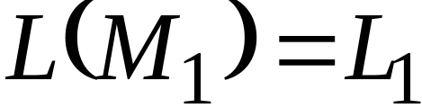
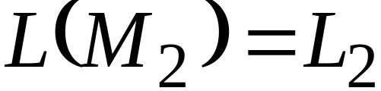


Regular language
Regular language
NFA
NFA
Single final state
Single final state

Slide 10

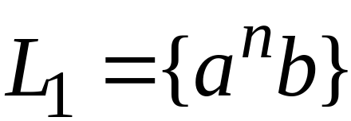
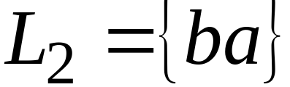
Example

Slide 11
Union
NFA for

Slide 12
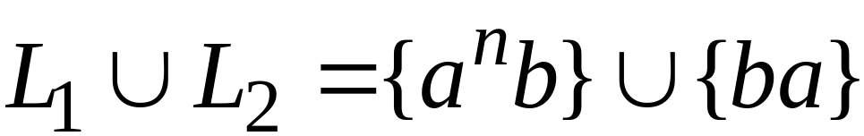
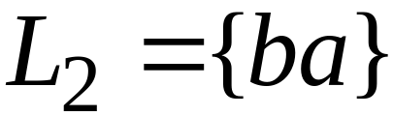
Example
NFA for

Slide 13
Concatenation
NFA for

Slide 14
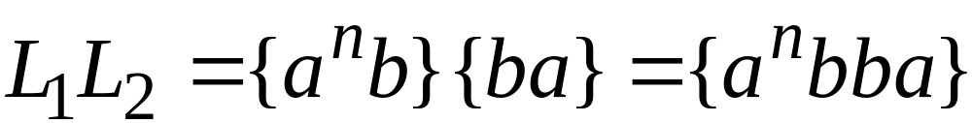
Example
NFA for

Slide 15
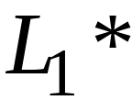
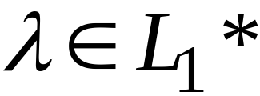
Star Operation
NFA for

Slide 16
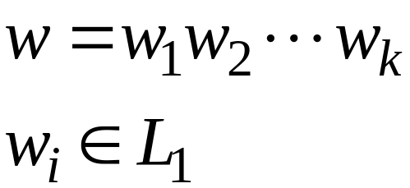
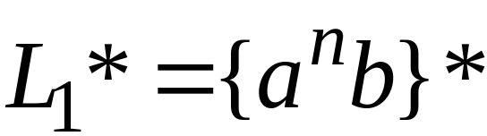
Example
NFA for

Slide 17

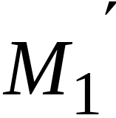
Reverse
NFA for
1. Reverse all transitions
2. Make initial state final state
and vice versa

Slide 18
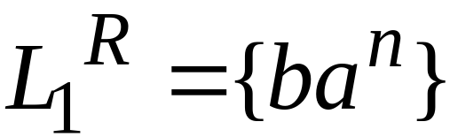
Example

Slide 19
Complement
1. Take the DFA that accepts
2. Make final states non-final,
and vice-versa

Slide 20

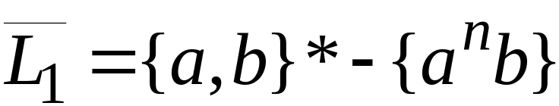
Example

Slide 21




Intersection
DeMorgan’s Law:
regular
regular
regular
regular
regular

Slide 22
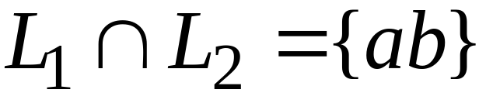
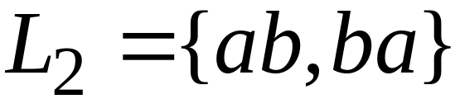
Example
regular
regular
regular

Slide 23
Regular Expressions

Slide 24
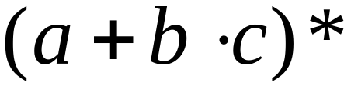
Regular Expressions
Regular expressions
describe regular languages
Example:
describes the language

Slide 25
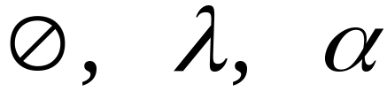



Recursive Definition
Primitive regular expressions:
Given regular expressions and
Are regular expressions

Slide 26
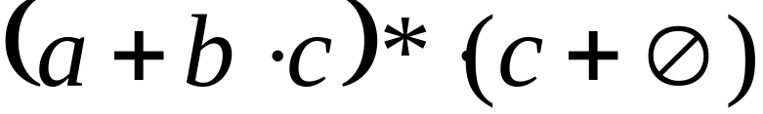
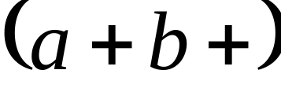
Examples
A regular expression:
Not a regular expression:

Slide 27
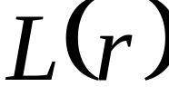

Languages of Regular Expressions
: language of regular expression
Example

Slide 28
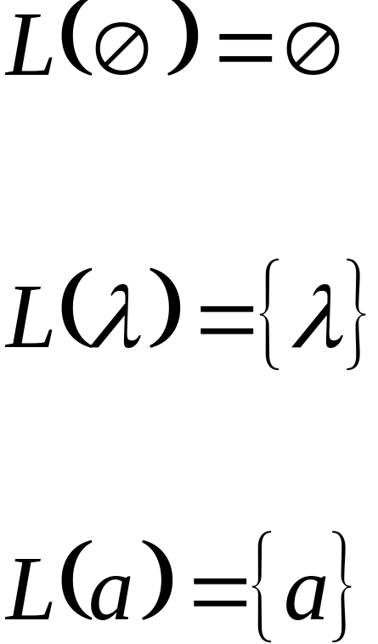
Definition
For primitive regular expressions:

Slide 29


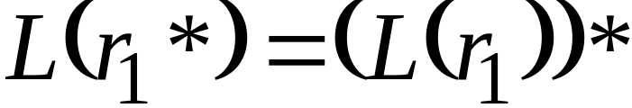

Definition (continued)
For regular expressions and

Slide 30

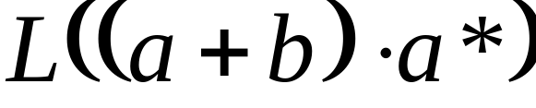


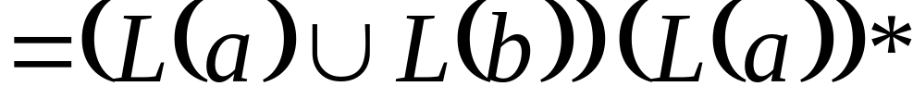
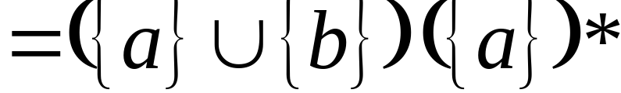
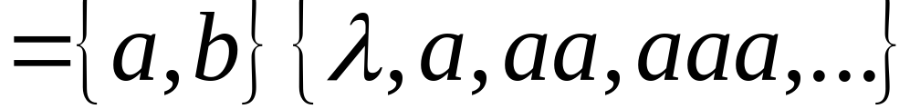
Example
Regular expression:

Slide 31

Example
Regular expression

Slide 32


Example
Regular expression

Slide 33


Example
Regular expression
= { all strings with at least
two consecutive 0 }

Slide 34
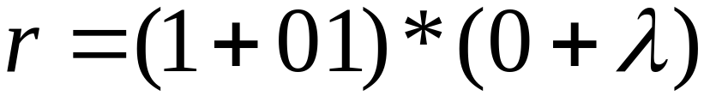
Example
Regular expression
= { all strings without
two consecutive 0 }

Slide 35

Equivalent Regular Expressions
Definition:
Regular expressions and
are equivalent if

Slide 36

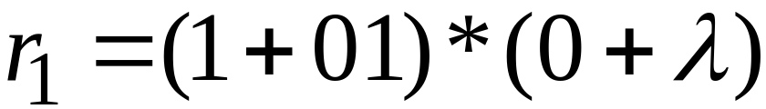

Example
= { all strings without
two consecutive 0 }
and
are equivalent
regular expr.

Slide 37
Regular Expressions and
Regular Languages

Slide 38

Theorem
Languages
Generated by
Regular Expressions
Regular
Languages

Slide 39

Theorem - Part 1
Languages
Generated by
Regular Expressions
Regular
Languages
1. For any regular expression
the language is regular

Slide 40

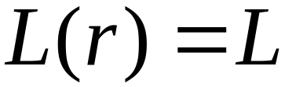
Theorem - Part 2
Languages
Generated by
Regular Expressions
Regular
Languages
2. For any regular language there is
a regular expression with

Slide 41
Proof - Part 1
1. For any regular expression
the language is regular
Proof by induction on the size of

Slide 42
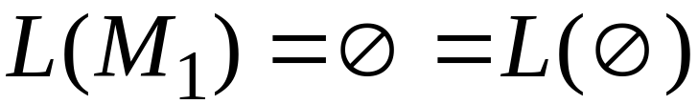
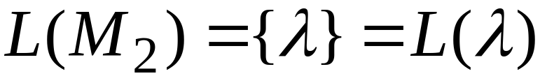

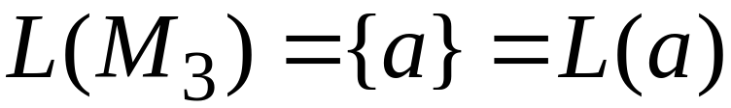
Induction Basis
Primitive Regular Expressions:
NFAs
regular
languages

Slide 43
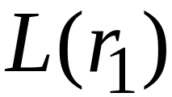
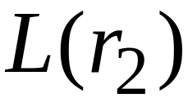
Inductive Hypothesis
Assume
for regular expressions and
that
and are regular languages

Slide 44
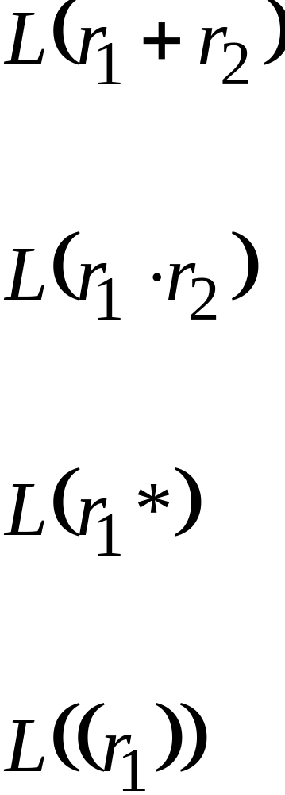
Inductive Step
We will prove:
Are regular
Languages

Slide 45
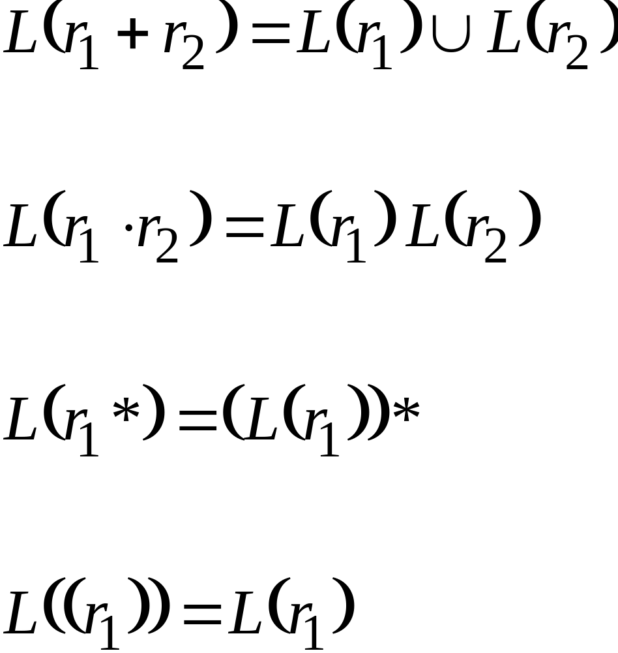
By definition of regular expressions:

Slide 46
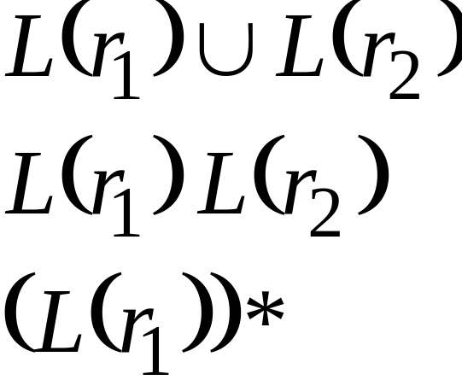
By inductive hypothesis we know:
and are regular languages
We also know:
Regular languages are closed under:
Union
Concatenation
Star

Slide 47
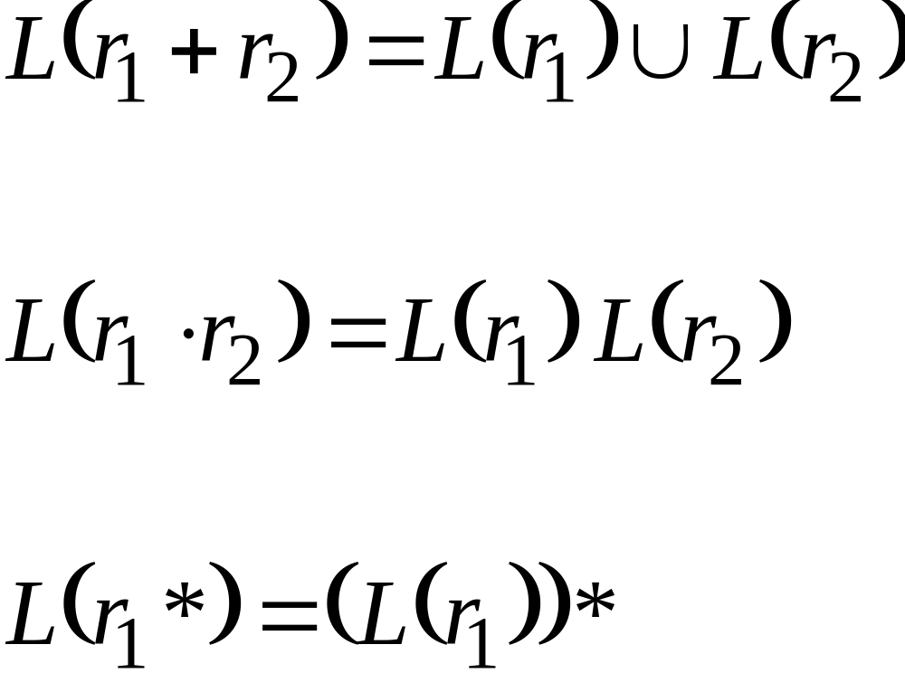
Therefore:
Are regular
languages

Slide 48
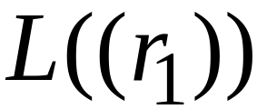
And trivially:
is a regular language

Slide 49
Proof – Part 2
2. For any regular language there is
a regular expression with
Proof by construction of regular expression

Slide 50

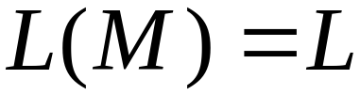
Since is regular take the
NFA that accepts it
Single final state

Slide 51



From construct the equivalent
Generalized Transition Graph
in which transition labels are regular expressions
Example:

Slide 52



Another Example:

Slide 53

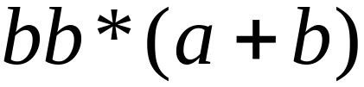
Reducing the states:

Slide 54
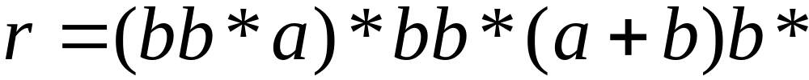
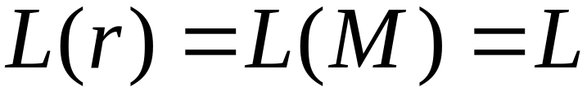
Resulting Regular Expression:

Slide 55









In General
Removing states:

Slide 56





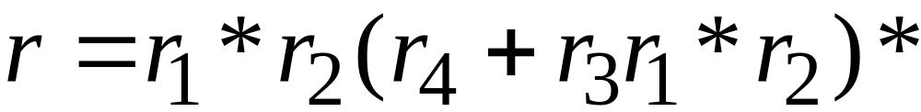
The final transition graph:
The resulting regular expression:

